Slide 1
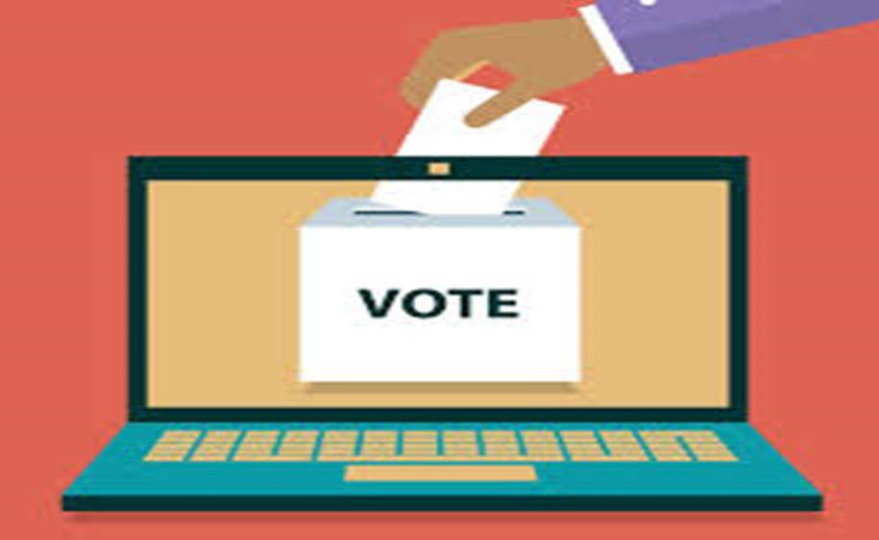
IMPROVED VOTING SYSTEM TO MITIGATE FAKE VOTING AND SECURITY ISSUES
SUBMITTED BY
Name | Roll No. | Reg. No
Debika Karak | Roll-VU/PG/20/32/02-IVS No-0052 | Reg. No-0000533 of 2017-2018
Malay Mondal | Roll-VU/PG/20/32/02-IVS No-0025 | Reg. No-001078 of 2020-2021
Sayan Debnath | Roll-VU/PG/20/32/02-IVS No-0015 | Reg. No-00337 of 2020-21
DEPARTMENT OF COMPUTER SCIENCE
VIDYASAGAR UNIVERSITY
GUIDANCE Dr. ARNAB SADHU

Slide 2
INTRODUCTION:
Problems with the current voting system:
Fake Voting
Security
Solutions in Literature:
Online Voting Systems are proposed by Agarwal et. al.[1], Cramer et. al. [2], Kirillov et. al. [3].
Issues with OVS:
Unavailability of seamless connectivity.
Lack of digital literacy.
Goal:
We have to have a system that is easy to operate yet very efficient.

Slide 3
We propose an “IMPROVED VOTING SYSTEM TO MITIGATE FAKE VOTING AND SECURITY ISSUES”.
Features:
One target fake voting through fingerprint based authentication.
Improved Security through use of blockchain.

Slide 4
Registration
Phases
Voting
Counting

Slide 5
Phase 1 : Registration

Slide 6
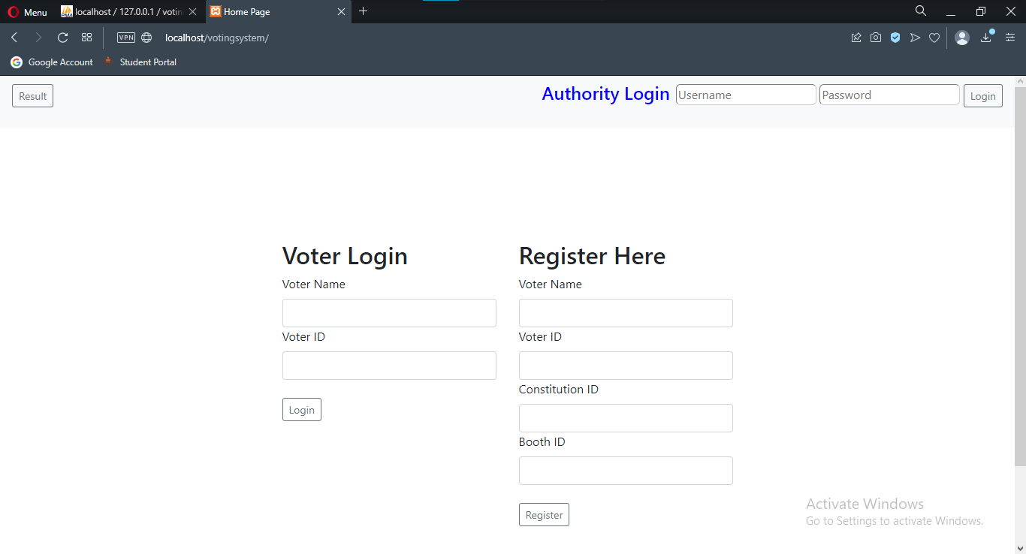
Home Page:

Slide 7



Authorities
P.O- Presiding Officer.
D.I.O – District Investigation Officer
C.E.O – Chief Election officer.

Slide 8
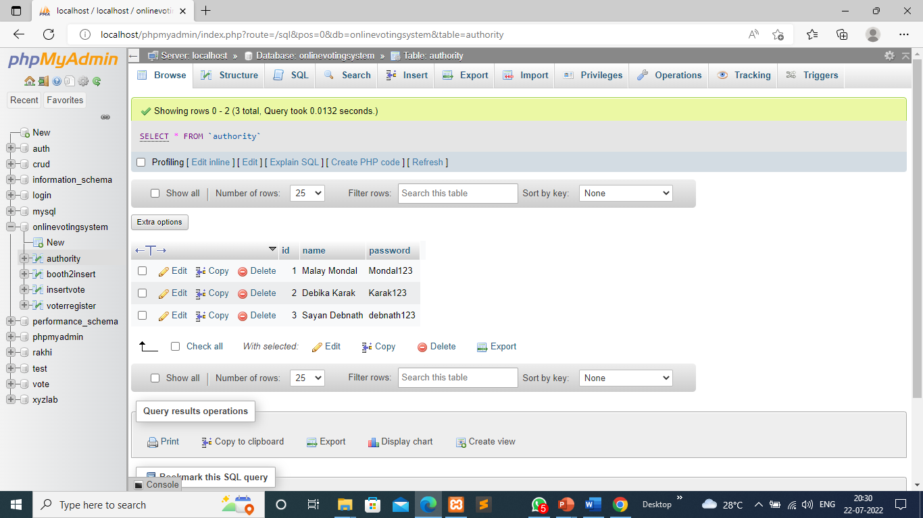
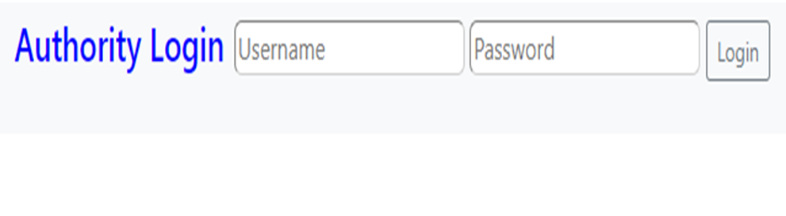
Admin Page:

Slide 9
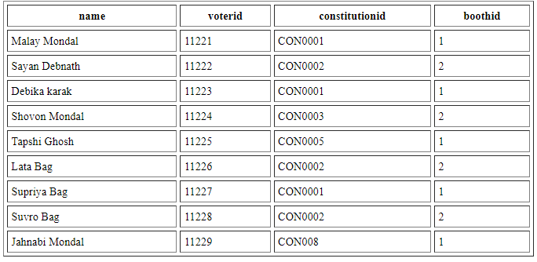
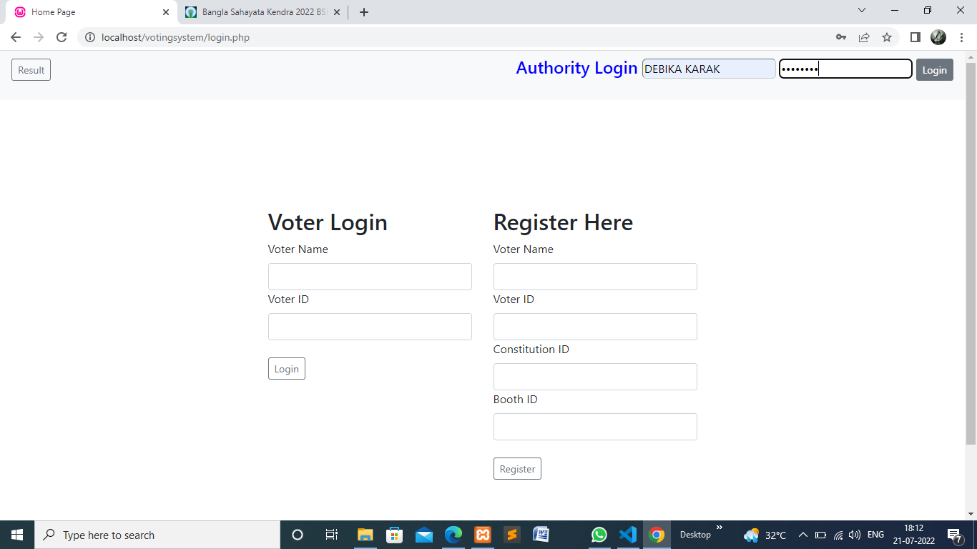
Authority Display the page:

Slide 10
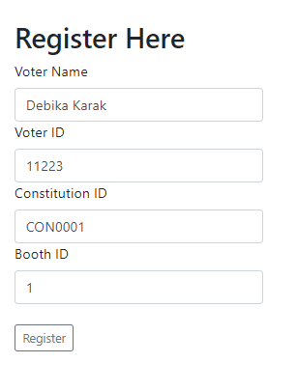
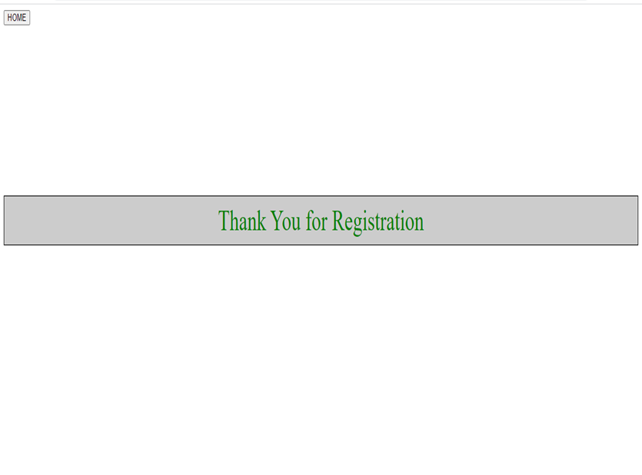
Voter’s Registration Page:

Slide 11
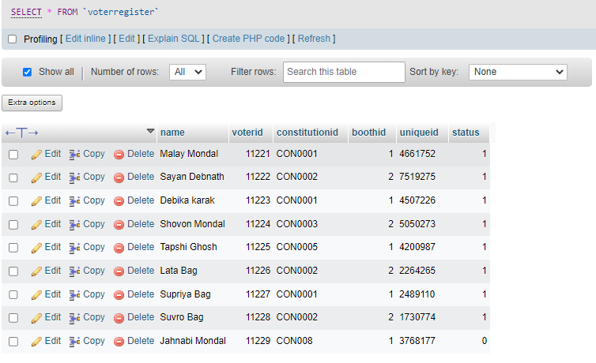
Voter Register Table:
Voted
Not voted

Slide 12
Phase 2: Voting

Slide 13
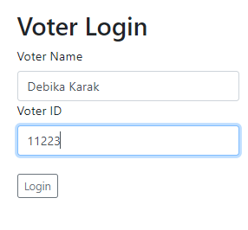
Voter’s Login Process:

Slide 14
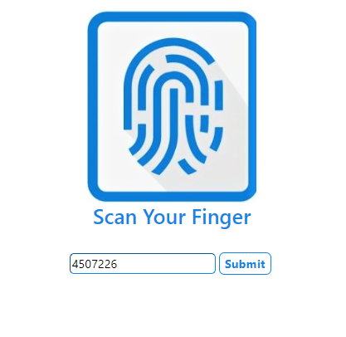
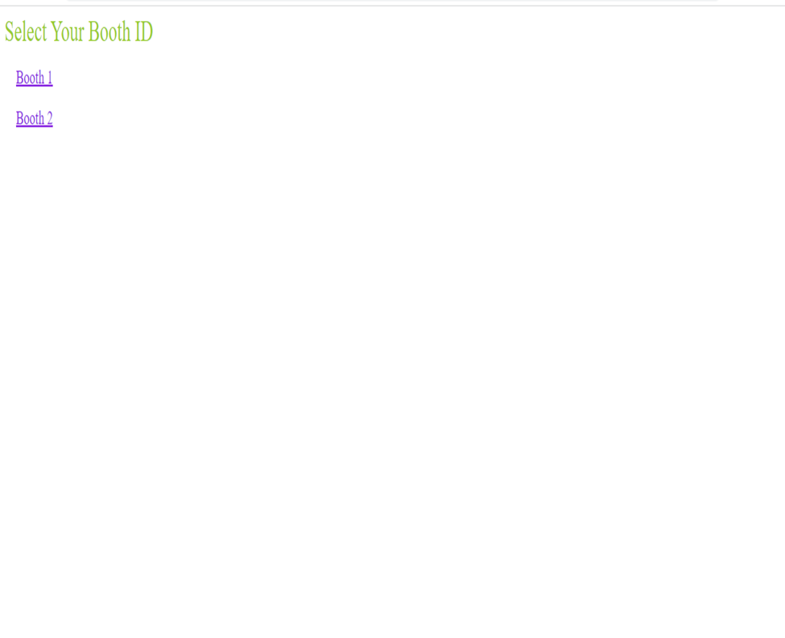
Fingerprint Verifying Page:

Slide 15
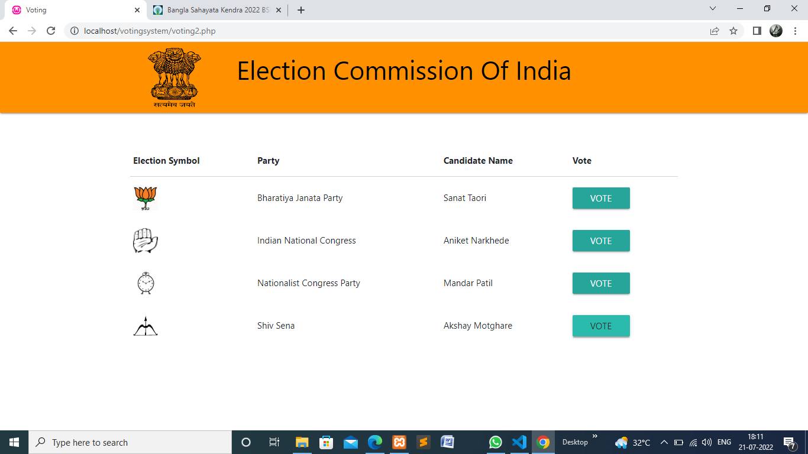
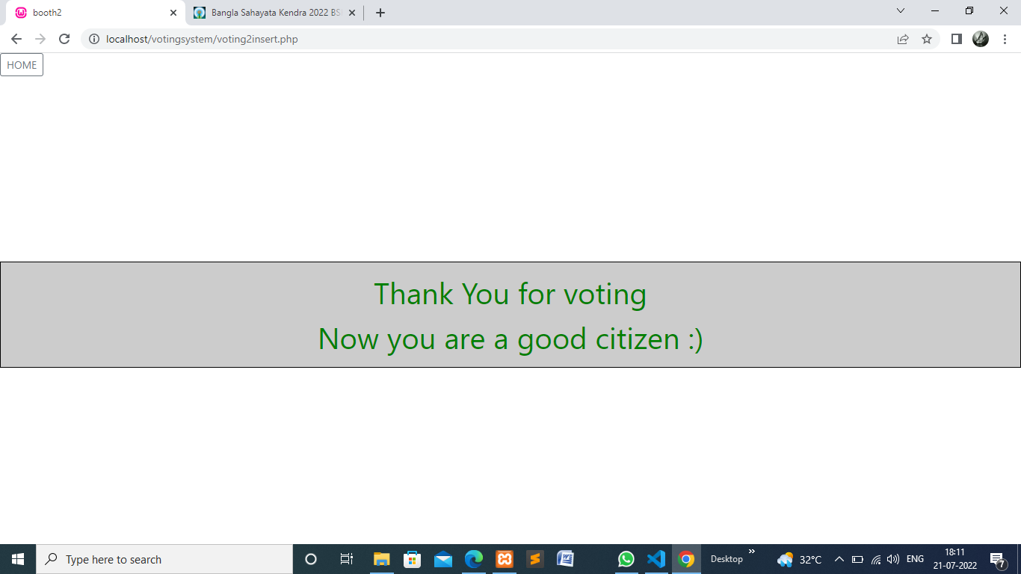
Voting portal:

Slide 16
Blockchain:
Blockchain is a system of recording information in a way that makes it difficult or impossible to change, hack, or cheat the system. A blockchain is essentially a digital ledger of transactions that is duplicated and distributed across the entire network of computer systems on the blockchain.

Slide 17
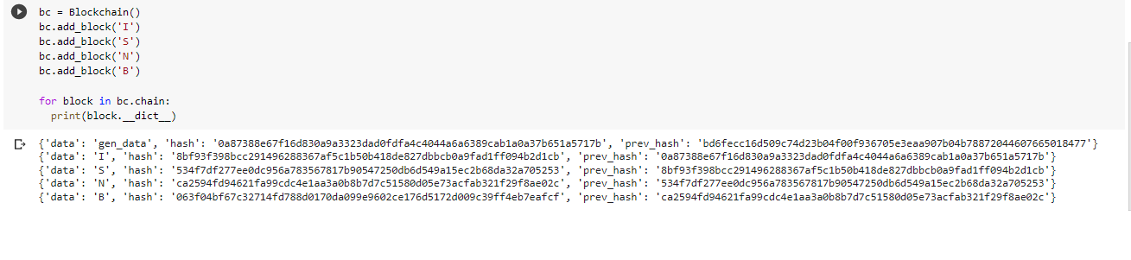
Booth:1
Block: 1
Block: 2
Data | I
Pre Hash | 0a87388e67f16d830a9a3323dad0fdfa4c4044a6a6389cab1a0a37b651a5717b
Hash | 8bf93f398bcc291496288367af5c1b50b418de827dbbcb0a9fad1ff094b2d1cb
Data | S
Pre Hash | 8bf93f398bcc291496288367af5c1b50b418de827dbbcb0a9fad1ff094b2d1cb
Hash | 534f7df277ee0dc956a783567817b90547250db6d549a15ec2b68da32a705253
Block: 4
Block: 3
Data | B
Pre Hash | ca2594fd94621fa99cdc4e1aa3a0b8b7d7c51580d05e73acfab321f29f8ae02c
Hash | 063f04bf67c32714fd788d0170da099e9602ce176d5172d009c39ff4eb7eafcf
Data | N
Pre Hash | 534f7df277ee0dc956a783567817b90547250db6d549a15ec2b68da32a705253
Hash | ca2594fd94621fa99cdc4e1aa3a0b8b7d7c51580d05e73acfab321f29f8ae02c

Slide 18
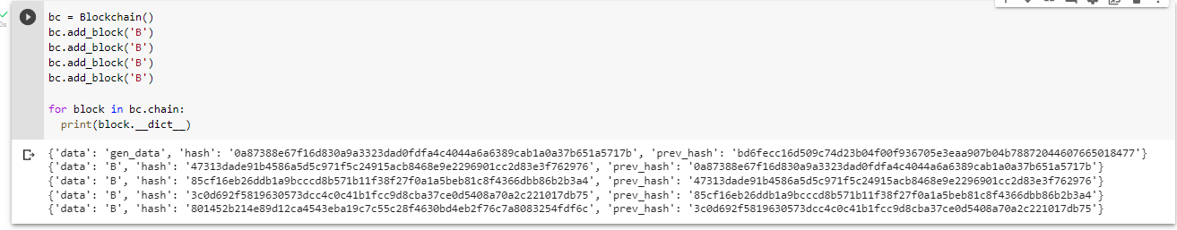
Booth:2
Block: 1
Block: 2
Data | B
Pre Hash | 0a87388e67f16d830a9a3323dad0fdfa4c4044a6a6389cab1a0a37b651a5717b
Hash | 47313dade91b4586a5d5c971f5c24915acb8468e9e2296901cc2d83e3f762976
Data | B
Pre Hash | 47313dade91b4586a5d5c971f5c24915acb8468e9e2296901cc2d83e3f762976
Hash | 85cf16eb26ddb1a9bcccd8b571b11f38f27f0a1a5beb81c8f4366dbb86b2b3a4
Block: 3
Block: 4
Data | B
Pre Hash | 85cf16eb26ddb1a9bcccd8b571b11f38f27f0a1a5beb81c8f4366dbb86b2b3a4
Hash | 3c0d692f5819630573dcc4c0c41b1fcc9d8cba37ce0d5408a70a2c221017db75
Data | B
Pre Hash | 3c0d692f5819630573dcc4c0c41b1fcc9d8cba37ce0d5408a70a2c221017db75
Hash | 801452b214e89d12ca4543eba19c7c55c28f4630bd4eb2f76c7a8083254fdf6c

Slide 19
Block 1
Hash
Block 2
Pre Hash
Block 2
Hash
Block 3
Pre Hash
Block 3
Hash
Block 4
Pre Hash
Block 4
Hash
Here, block 4 is a main hash.

Slide 20



Structure of data flow
Store the hash data
Hash
block
4
Hash 5
send
P.O
CEO
send
This hash is collected by P.O and send it to the DIO and CEO.
This hash will send to CEO BY DIO’s signature verification
DIO

Slide 21
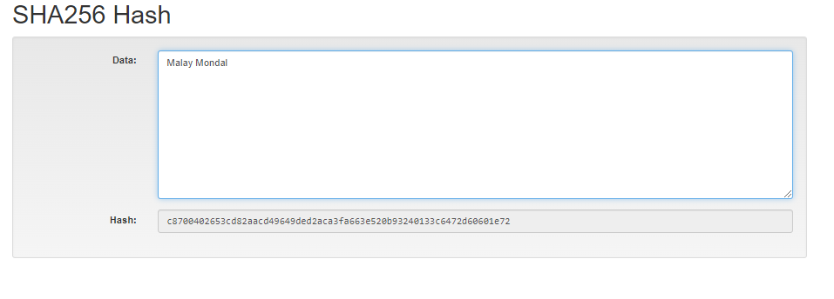
DIO’S signature
As an example, here Malay Mondal is the DIO.
That hash code will verify the signature.
This signature will be verified by CEO.
If the signature is verified then the vote will be considered as genuine.

Slide 22

Store the all hash data
Hash 4
SEND
Hash 4
Data
P.0
P.O and DIO send hash 5 data to CEO
send
Check all the hash and verify with digital signature
Verify
SEND
genuine
DIO
CEO
V
O
T
E

Slide 23
Phase 3 : Counting

Slide 24
Voter Register Table:
Voted
Not voted

Slide 25
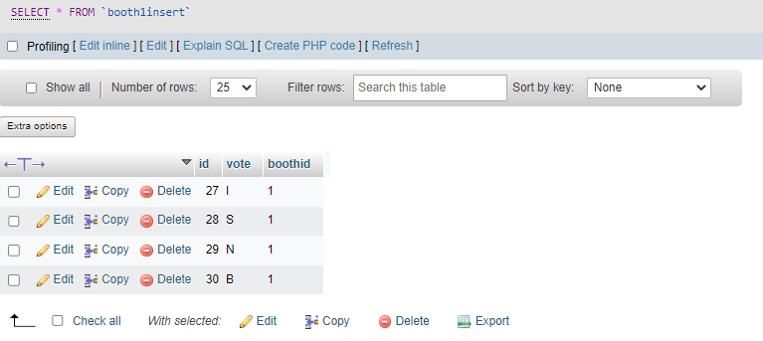
Table to store votes of booth 1:

Slide 26
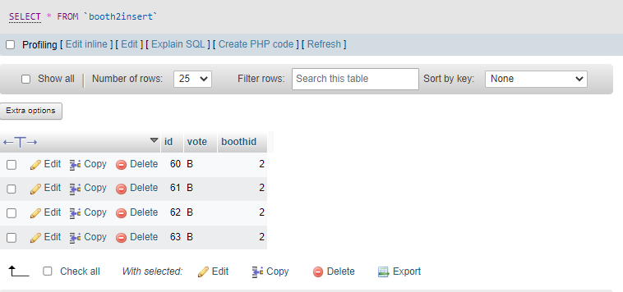
Table to store votes of booth 2:

Slide 27
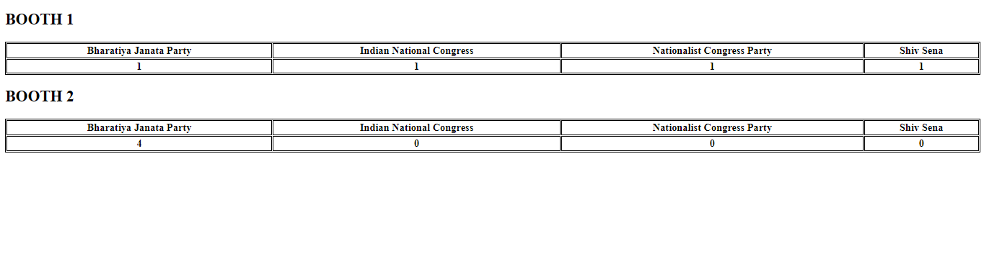
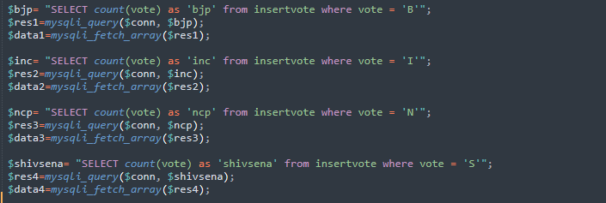
Result :

Slide 28
voters can log in and use their voting rights.
It is very easy to debug.
There is a DATABASE that is maintained by a central authority in which all the names of the voter with complete information is stored.
A person who is above the 18 years old ,they can eligible for vote.
Voting detail stored in the database and the result is displayed by calculation.
It is very easy to use.
we can implement blockchain more perfectly.
Develop the Android App.
With the availability of hardware we can synchronize the processes.
CONCLUSION
FUTURE WORK

Slide 29
[1] H. Agarwal and G. N. Pandey, "Online voting system for India based on AADHAAR ID," 2013 Eleventh International Conference on ICT and Knowledge Engineering, 2013, pp. 1-4, doi: 10.1109/ICTKE.2013.6756265.
[2] R. Cramer, R. Gennaro, and B. Schoenmakers, “A secure and optimally efficient multi-authority election scheme,” European transactions on Telecommunications, vol. 8, no. 5, pp. 481–490, 1997.
[3] D. Kirillov, V. Korkhov, V. Petrunin, M. Makarov, I. M. Khamitov, and V.Dostov, “Implementation of an e-voting scheme using hyperledger fabric permissioned blockchain,” in International Conference on Computational Science and Its Applications. Springer, 2019, pp. 509–521
REFERENCE

Slide 30
THANK YOU

